Slide 1

Marketing Realtime Report
A Dynamic Data Pipeline for Real-Time Business Insights

Slide 2
Section Break

Slide 3
01
Context
Business requirements
Project objectives
Target Users
02
Approach
Data collection
Tool and Technologies
03
Overview system architecture
Solution
Data processing flow
Optimization strategies
04
Result
Results
05
Demo

Slide 4

Context

Slide 5
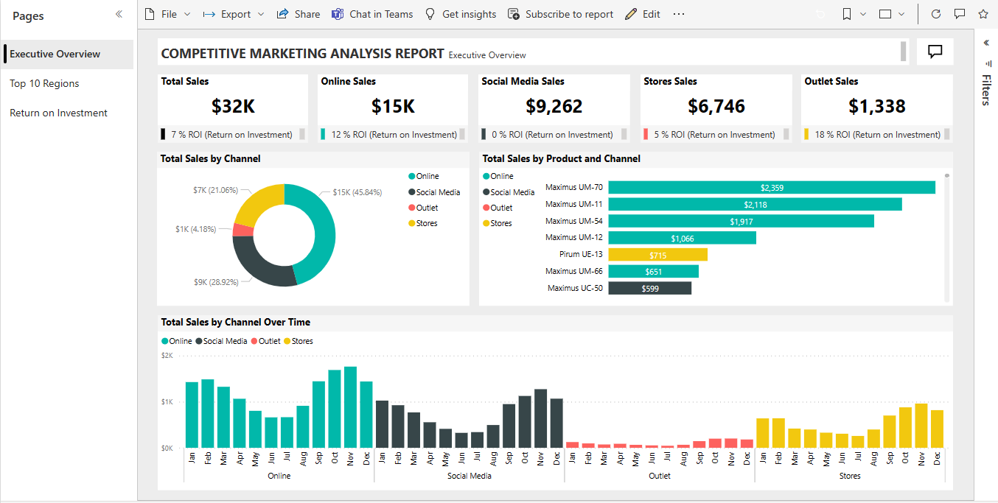
What’s real time report ?
Report is created by BI tools, which connect to change stream database

Slide 6

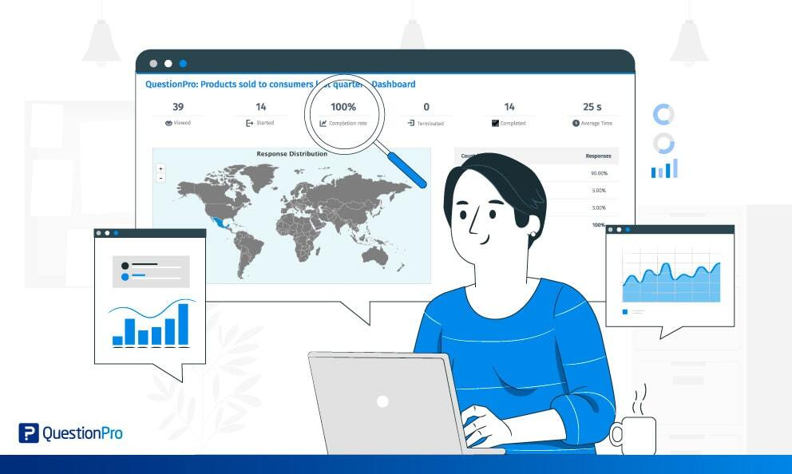

Benefit of real time report
Faster Decision-Making
Enhanced Customer Experience
Early Problem detect
Target Users
Data analysis
Marketing team
Manager

Slide 7

Project objective
Demonstrate a Realtime Reporting System
Explore technologies, framework for building Realtime Reporting System
Identify challenges and strategies solution

Slide 8


Approach

Slide 9
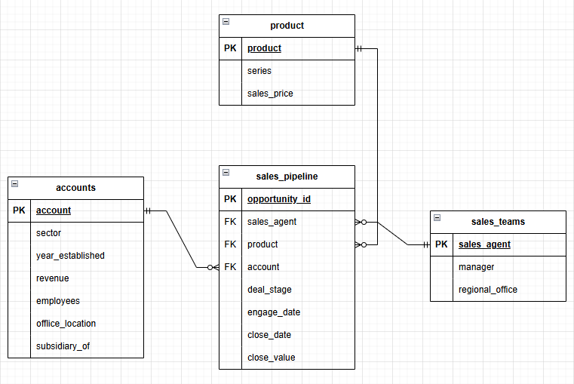
Data Collection
GPU sale market. Static Dataset in github

Slide 10



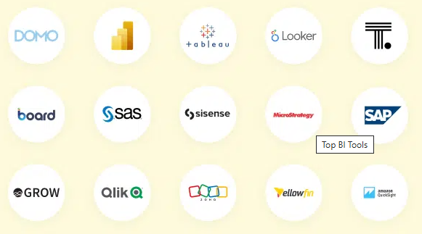




Slide 11
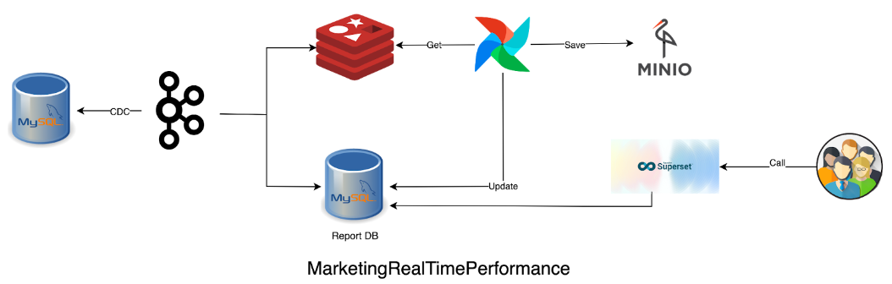

Slide 12

Apache Kafka
Publish/Subcribe protocol
Kafka ecosystem
Kraft mode
Kafka Stream
KSQL DB
Kafka connect
Schema Registry
Client operate independently.
Scalable and efficient.
Simplified Maintenance.
Back pressure.
Scalability
Exactly Once Semantics
Replicate broker for storage
Replicate partition
EOS đảm bảo các message được xử lý duy nhất 1 lần bởi consumer group.
Trasactional Producer/Consumer

Slide 13
Change Data Capture (CDC)
A technique used to track and capture changes in database (such as CRUD record/table/schema/user, …)
CDC is a key component for modern streaming architectures, especially when building real-time analysis

Slide 14
Change Data Capture (CDC)
Query-based CDC
Trigger-based CDC
Log-based CDC
Use sql query to detect changes in database
Simply to implement
Heavy load on the database.
Use change to log changes into a separate log table
Complexity and impact database performance
Use transaction log to track changes
Doesn’t not affect database performance and can extract data as soon as changes occur
Requires access to transaction logs
This project use Log-based CDC – Debezium, which is a connector in kafka connect to CDC source Database to Kafka broker.

Slide 15
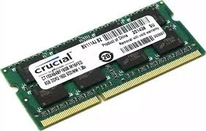
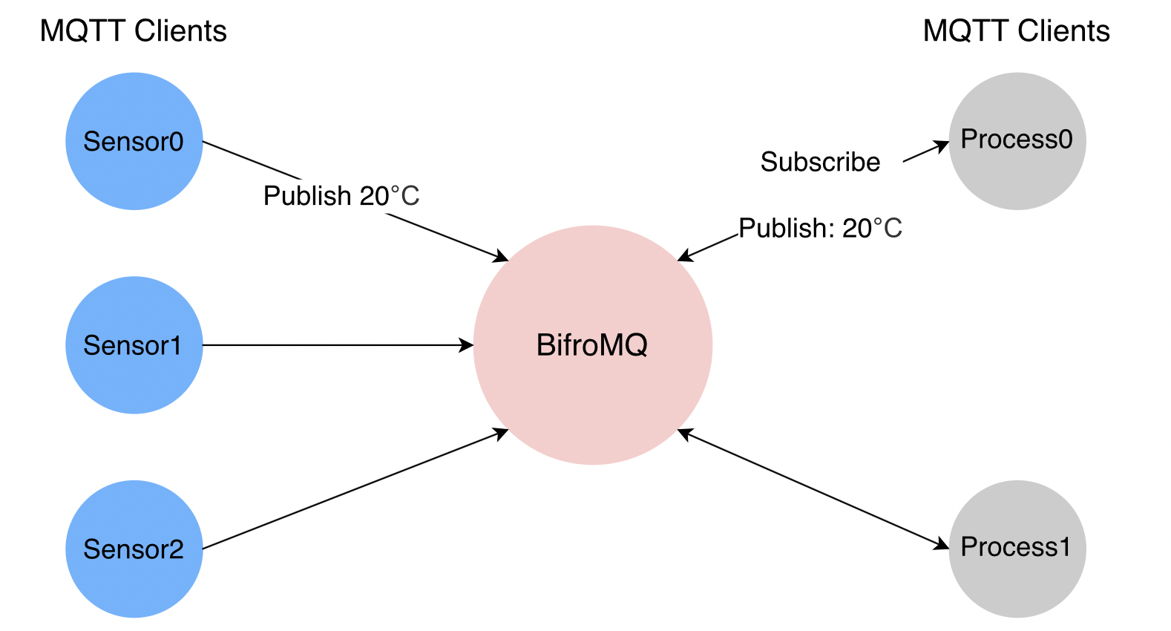

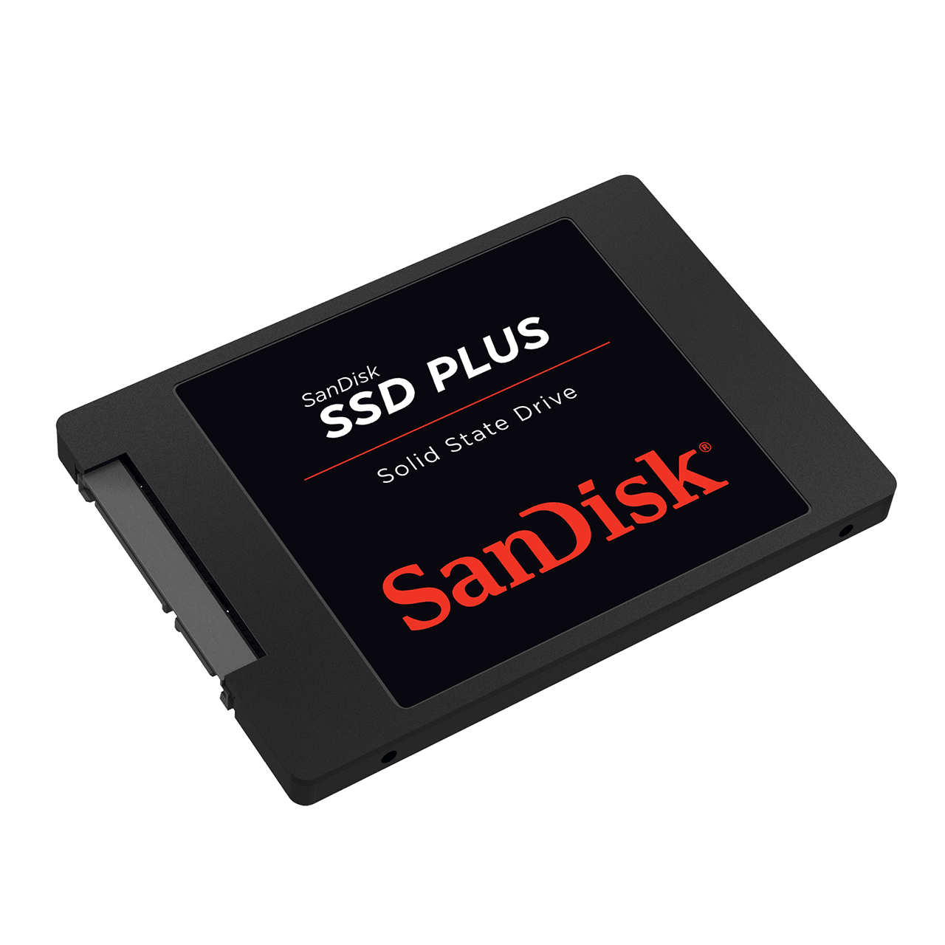
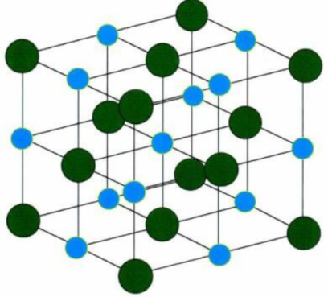

Redis
High performance
Pub/Sub Message System
Begin as a in-memory database, redis now develop as a fully fledged primary database. It’s can persisting data on disk and ram.
Redis provides a publish/subscribe (Pub/Sub) messaging paradigm that allows clients to send and receive messages in real time.
Data structure
Replication and High Avaibility
Support many data structure such as String, Lists, Sets, Sorted Sets, Hashs, …
Get a modern PowerPoint Presentation that is beautifully designed. I hope and I believe that this Template will your Time.
Persistence Options
Redis on flash
Redis offers persistence features that allow data to be stored on disk for durability. RDB, AOF features
Enterprise feature. Redis computes to only store frequently used values ​​on ram to minimize memory overflow

Slide 16


Solution

Slide 17
Use Kraft mode to set up Kafka cluster
Use Kafka connect to support Debezium deployments
Using Schema Registry to save the schema of messages. Use Avro format to makes the messages in Kafka lighter and ensures schema consistency within a topic.
Using confluent-kafka to take advantage of kafka confluent platform
Using confluent-kafka to take advantage of kafka confluent platform.

Slide 18


Slide 19
Demo

Slide 20
THANK YOU

